Slide 1
Evgeny Smirnov Associate Director, Policy Advisor Procurement Policy and Advisory Department European Bank for Reconstruction and Development
VARIATION CLAUSES
the public sector and MDB perspective

Slide 2
Variation clauses from the public sector and MDB perspective PROCUREMENT EXPERT AND FINANCIERS’ PERSPECTIVE

Slide 3
European Bank for Reconstruction and Development
International financial organisation established in 1991
Capital base – EUR 30 billion
Credit rating of AAA by Standard & Poor's, Moody's
and Fitch
Shareholders of the Bank
Two international organisation and 65 countries.
Mission
The Bank promotes transition to market economies in 38 countries from Central Europe to Central Asia, as well as in the SEMED region.
The Bank promotes policy dialogues with regards to investment climate, business environment and policy matter.
Notes:
4

Slide 4
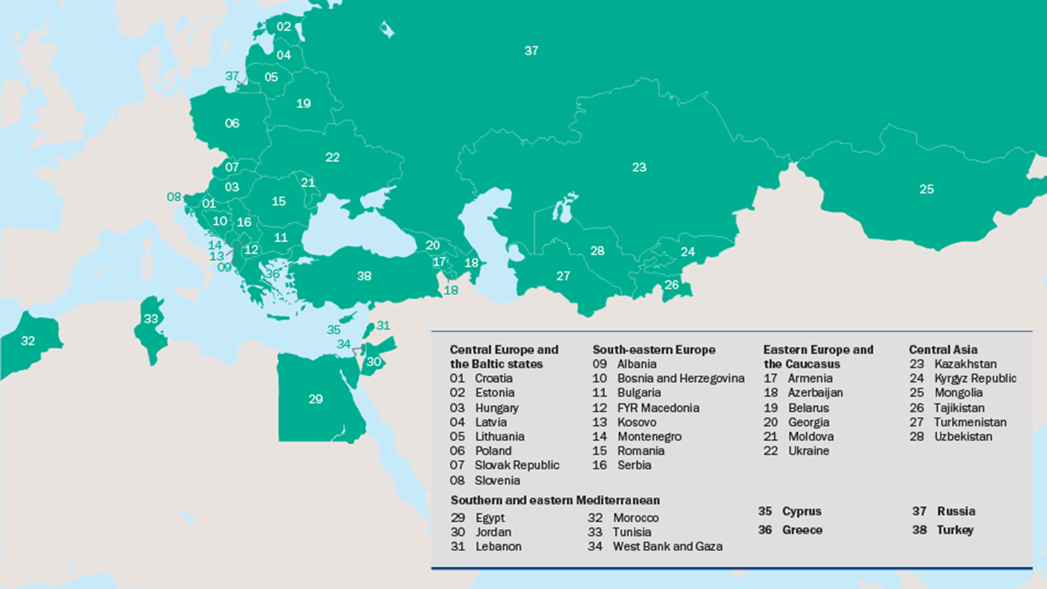
5,000 Projects
EURO 115 billion EURO
75 per cent – private sector
25 per cent – public sector
Notes:
7

Slide 5
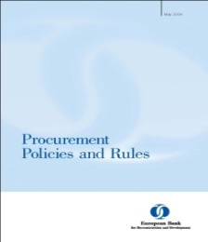
EBRD PROCUREMENT POLICIES AND CONCESSION PAPERS
DOCUMENT OF THE EUROPEAN BANK FOR RECONSTRUCTION AND DEVELOPMENT EBRD FINANCING OF PRIVATE PARTIES TO CONCESSIONS
Notes:
1

Slide 6
MAIN PRINCIPLES
ECONOMIC use of resources
EFFICIENT project implementation
Project results shall be of due QUALITY
NON-DISCRIMINATORY process
TRANSPARENT AND RESPONSIBLE use of public funds

Slide 7
THE CLIENT’S ROLE DURING IMPLEMENTATION
Implement projects in line with laws and agreements
The clients are responsible for all aspects of the procurement of contracts.
They invite, receive and evaluate tenders and awards contracts, which in all cases are concluded between the clients and the suppliers/contractors/consultants.
Notes:
7

Slide 8
THE BANK’S ROLE
Advise clients
Assist clients in the course of project implementation
Ensure that the implementation is in line with agreements
Review procurement actions
Review complaints
In private sector undertakes due diligence and monitors projects to ensure that value for money is obtained
Notes:
8

Slide 9
BANK’S APPROACH IN PUBLIC PROCUREMENT
Procurement – an integral part of project risk management
Minimisation of risks – Maximisation of success
Coverage of the entire project cycle
Procurement – part of project delivery strategy
Balanced risk distribution
Use of standard tender documents and internationally recognised contract terms and conditions
Aim of evaluation – best value for money
Evaluation factors usually are expressed in monetary terms
The key to success – people
Assistance to the clients
Prevention and fighting corruption

Slide 10
Agreement establishing the European bank for Reconstruction and Development
Chapter III: Operations
Article 13: Operating principles
The Bank shall operate in accordance with the following principles:
(xiii) the Bank shall take the necessary measures to ensure that the proceeds of any loan made, guaranteed or participated in by the Bank, or any equity investment, are used only for the purposes for which the loan or the equity investment was granted and with due attention to considerations of economy and efficiency.
Procurement Policies and Rules
Contract Administration
3.30 The client shall administer contracts with due diligence and shall monitor and periodically report to the Bank on the performance of contracts.
3.31 Before agreeing to any modification or waiver of the terms and conditions of a contract or granting an extension of the stipulated time for performance (except in cases of extreme urgency brought about by unforeseeable events not attributable to the procuring entity), the client shall obtain the Bank’s no objection to the proposed modification, waiver or extension. Change or variation orders made in accordance with the terms and conditions of the contract shall be subject to the Bank’s review before a no objection can be given for disbursement.

Slide 11
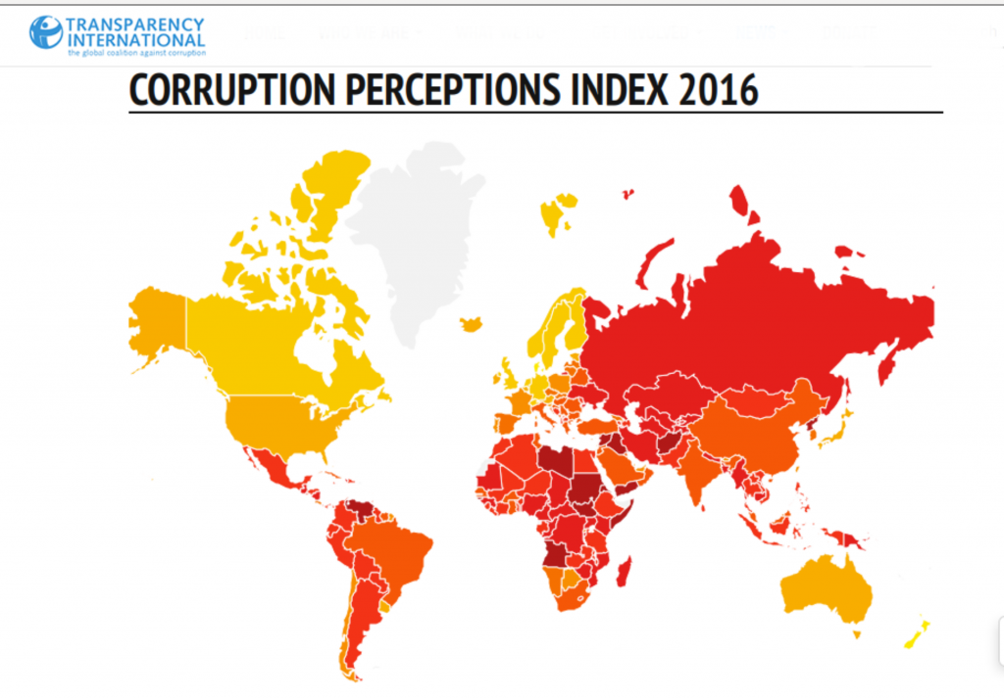
PROHIBITED PRACTICES
Corrupt practices
Fraudulent practices
Coercive practices
Collusive practices
Obstructive practices
Theft
Misuse of the Bank’s resources

Slide 12
BEWARE OF CORRUPTION
Analysis
Identification
Prevention
Monitoring
Audit
Liquidation
where
C – corruption M – monopoly
A – authority I – influence
R – responsibility T – transparency
E – ethical standards U – undefined (other) factors
Notes:
Examples:
Rent seeking opportunities
- single tender, negotiated contracts
- excessively high specifications or requirements, which can later be waived without detriment to the project
- regulatory approvals and controls that are unrelated to the quality or performance of the project.
Moral hazard
- tied sovereign guaranteed loans or grants such as bilateral aid
Conflict of interest
- shareholder is also contractor
- consultant/contractor relationship
- financier supervises procurement and is also in a potential relationship with one or more tenderers
- multiple tenders by one contractor
- collusive agreements between contractors
During project execution, monitoring and audit is a powerful deterrent against corruption:
- adequate records and files
- an audit trail
Formula is illustrative.
Corruption has to be addressed from the project design stage by identifying and removing the situations and relationships which create an environment which is conducive to corruption.

Slide 13
KEY CONSIDERATIONS
You need two to tango
Key factors
Influence
Competence
Payment
Every day the world gets more sophisticated and complex
Every stage of a project shall be watched
Procurement planning/packaging
Preparation of prequalification and/or tender documents
Tendering process
Evaluation
Contract signing
Contract implementation

Slide 14
MOST TYPICAL RED FLAGS
Contract implementation
Variations, especially introducing new works, which have no rates in the contract
Unforeseen changes to the circumstances
Low quality (especially in concealed works )
Falsified documents
“Puppet” supervisors/engineers
Mock “tough negotiations”
“Amicable” settlements
Convenient adjudicators
Lack of appetite to call guarantees for poor performance or delays
Unclear destiny of temporary works and equipment
Vague subcontracting

Slide 15
WHAT IS OUR POSITION?
All standard internationally recognised contract terms and conditions, used on the Bank’s funded projects, provide for a possibility to the parties to make changes to them
The Bank’s experience shows that almost all contracts are subject to the Modifications in the course of their implementation though to a different degree. Works contract are the most frequently modified, whilst the goods supply contracts – the least
The Bank accepts that modifications may happen, though endeavours to minimise them on its projects
Whilst reviewing the modifications, the Bank’s focuses on following key issues:
economy
efficiency
fairness and
lack of corruption

Slide 16
WHAT DO WE DO ABOUT IT?
Education of clients
Use of well structured contracts (e.g. FIDIC)
Selection of highly qualified engineers/supervisors (with high professional integrity)
Introduction of DAB/DAAB concept
Use of lenders’ monitors
Regular monitoring of contract implementation
Site visits
Engagement of impartial experts/consultants for specific reviews

Slide 17
HOW TO CONTACT US
Procurement Policy and Advisory Department
Tel: +44 20 7338 6807/Fax: +44 20 7338 7472
Procurement opportunities via website:
http://www.ebrd.com/work-with-us/procurement/project-procurement.html
Project enquiries (existing EBRD projects only)
Tel: +44 20 7338 6372/Fax: +44 20 7338 7848
Business Development and project proposals
Tel: +44 20 7338 6372/Fax: +44 20 7338 7848
General enquiries
Tel: +44 20 7338 6629/Fax: +44 20 7338 6101
Publications
Tel: +44 20 7338 7553/Fax: +44 20 7338 6102

Slide 18
ძალიან დიდი მადლობა
Thank you very much!
18

